Slide 1
Management of Deep Carious Lesions in Children
Presented by
Gihan Abuelniel
Associate Professor of Pediatric Dentistry

Slide 7
Evaluation of treatment prognosis before pulp therapy :
Teeth that are good candidates for vital pulp therapy:
The level of patient and parent cooperation and motivation in receiving the treatment.
The level of patient and parent desire and motivation in maintaining the oral health and hygiene.
The caries activity of the patient and overall prognosis of oral rehabilitation
The degree of difficulty anticipated in performing pulp therapy in particular case.
Space management issues resulting from previous extractions
Pre-existing malocclusion, ankylosis, congenitally missing teeth and space loss caused by extensive carious destruction of teeth and subsequent drifting
Extensive extrusion of pulpally involved tooth resulting from absence of opposing teeth.

Slide 10
Diagnostic Aids

Slide 11
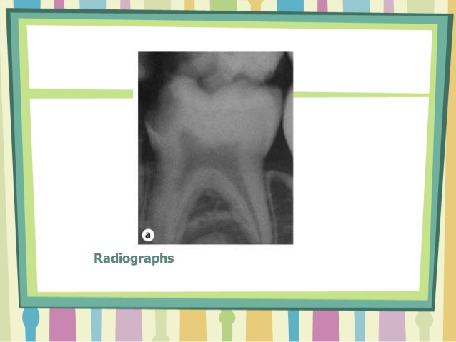
N.B : Children tend to be anxious plus false negative or positive response could be obtained

Slide 12
Treatment Options

Slide 37
